Slide 1
New York Library

Slide 2
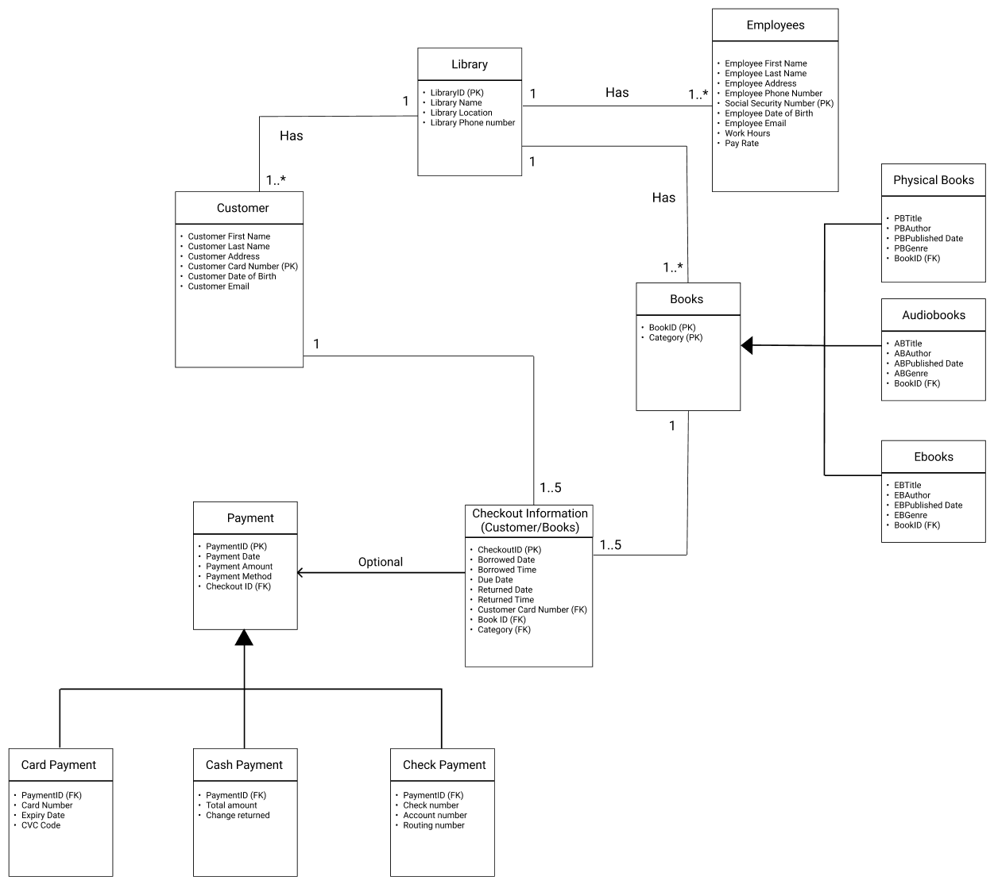
ER to Relational model

Slide 3
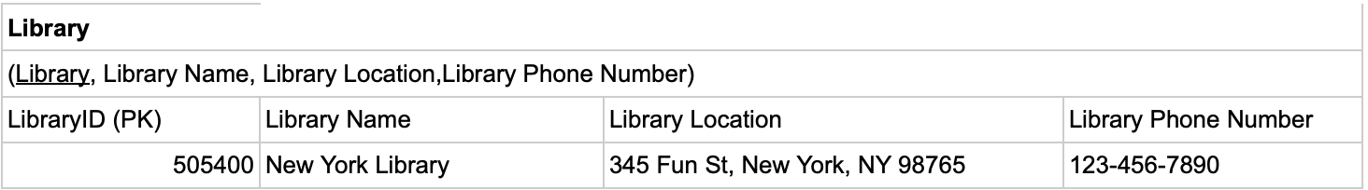
Normalization
Key: LibraryID
FD1: LibraryID → Library Name, Library Location, Library Phone Number
1NF: Meets the definition of the relations.
2NF: No partial dependencies
3NF: No transitive dependencies

Slide 4
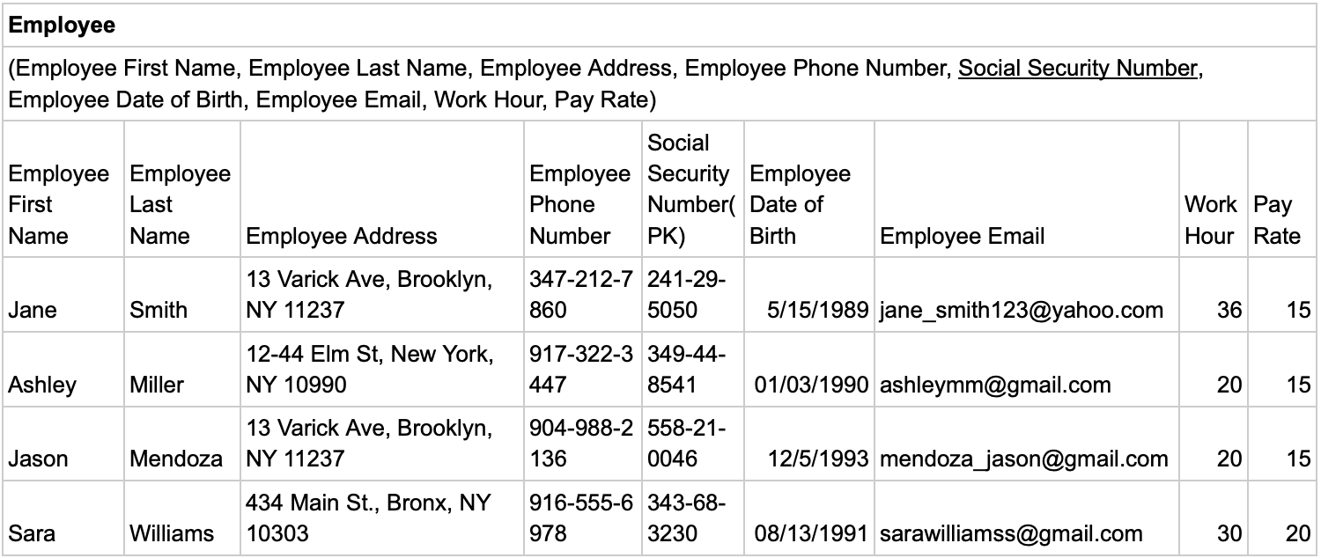
Normalization - Employees

Slide 5
Employees
Key: Social Security Number
FD1: Social Security Number → Employee First Name, Employee Last Name, Employee Address, Employee Phone Number, Employee Date of Birth, Employee Email, Work Hour, Pay Rate
FD2: Employee Phone Number → Employee First Name, Employee Last Name, Employee Address, Employee Date of Birth, Employee Email, Work Hour, Pay Rate
FD3: Employee Email → Employee First Name, Employee Last Name, Employee Address, Employee Phone Number, Employee Date of Birth, Work Hour, Pay Rate
1NF: Meets the definition of the relationship; only 1 key which determines all the other attributes, no duplicate records in any attribute
2NF: No partial key dependencies
3NF: Transitive dependencies exist: FD2, FD3.
After the normalization, BCNF: All determinants are candidate keys

Slide 6
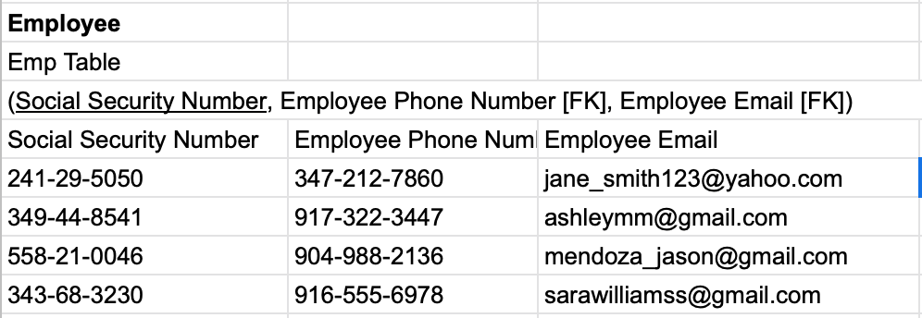
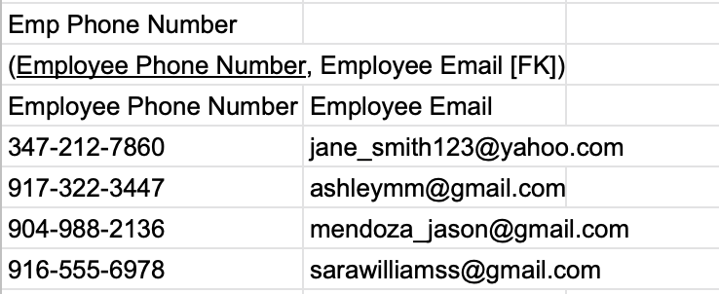
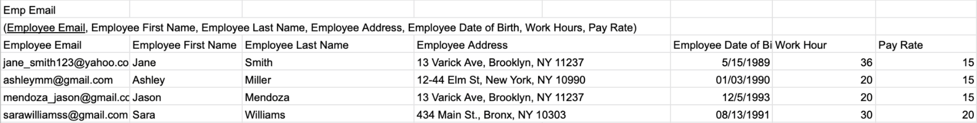
Normalization - Employees

Slide 7
Normalization - Customers
Customer
(Customer First Name, Customer Last Name, Customer Address, Customer Phone Number, Customer Card Number, Customer Date of Birth, Customer Email)
Customer First Name | Customer Last Name | Customer Address |  | Customer Phone Number | Customer Card Number (PK) | Customer Date of Birth | Customer Email
Jason | Lee | 123-21 blank street, Queens, NY 11456 |  | 917-213-2110 | 2365 | 1/12/2002 | Jason.Lee@gmail.com
Amy | Johnson | 481-89 Fulton street, Brooklyn, NY 11987 |  | 646-429-7651 | 9572 | 6/23/1996 | Amy.johnson@gmail.com
Kenny | Smith | 312-45 Jackson Ave, Queens, NY 11874 |  | 646-537-9185 | 8391 | 4/24/2005 | Kenny.Smith@gmail.com
Kelly | Rizzo | 212-65 Belmont Ave, Bronx, NY, 11512 |  | 917-487-3812 | 7548 | 4/12/1990 | Kelly.Rizzo@gmail.com
Billy | Wong | 762-172 Fort Washington Ave, Manhattan, NY 11932 |  | 917-641-2331 | 8571 | 12/23/1981 | Billy.wong@gmail.com

Slide 8
Customers
Key: Customer Card Number
FD1: Customer Card Number → Customer First Name, Customer Last Name, Customer Address, Customer Phone Number, Customer Date of Birth, Customer Email
FD2: Customer Email → Customer First Name, Customer Last Name, Customer Address, Customer Phone Number, Customer Date of Birth
FD3: Customer Phone Number → Customer First Name, Customer Last Name, Customer Address, Customer Date of Birth, Customer Email
1NF: Meets the definition of the relationship
2NF: No partial dependencies 3NF: Transitive dependencies exist: FD2, FD3
After the normalization, BCNF: All determinants are candidate keys

Slide 9
Normalization - Customers
Customer
Cust Table
(Customer Card Number, Customer Phone Number [FK], Customer Email [FK])
Customer Card Number | Customer Phone Number | Customer Email
2365 | 917-213-2110 | Jason.Lee@gmail.com
9572 | 646-429-7651 | Amy.johnson@gmail.com
8391 | 646-537-9185 | Kenny.Smith@gmail.com
7548 | 917-487-3812 | Kelly.Rizzo@gmail.com
8571 | 917-641-2331 | Billy.wong@gmail.com
Cust Phone Number
(Customer Phone Number, Customer Email [FK])
Customer Phone Number | Customer Email
917-213-2110 | Jason.Lee@gmail.com
646-429-7651 | Amy.johnson@gmail.com
646-537-9185 | Kenny.Smith@gmail.com
917-487-3812 | Kelly.Rizzo@gmail.com
917-641-2331 | Billy.wong@gmail.com

Slide 10
Normalization - Customers
Cust Email
(Customer Email, Customer First Name, Customer Last Name, Customer Address, Customer Date of Birth)
Customer Email | Customer First Name | Customer Last Name | Customer Address |  | Customer Date of Birth
Jason.Lee@gmail.com | Jason | Lee | 123-21 blank street, Queens, NY 11456 |  | 1/12/2002
Amy.johnson@gmail.com | Amy | Johnson | 481-89 Fulton street, Brooklyn, NY 11987 |  | 6/23/1996
Kenny.Smith@gmail.com | Kenny | Smith | 312-45 Jackson Ave, Queens, NY 11874 |  | 4/24/2005
Kelly.Rizzo@gmail.com | Kelly | Rizzo | 212-65 Belmont Ave, Bronx, NY, 11512 |  | 4/12/1990
Billy.wong@gmail.com | Billy | Wong | 762-172 Fort Washington Ave, Manhattan, NY 11932 |  | 12/23/1981

Slide 11
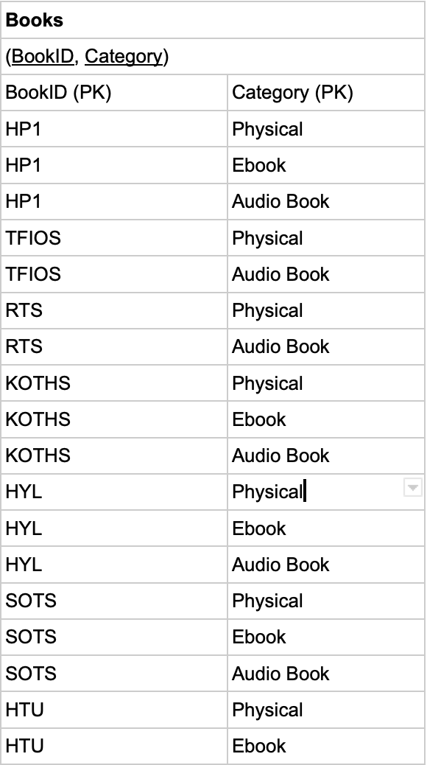
Normalization - Books
Keys: Books, Category

Slide 12
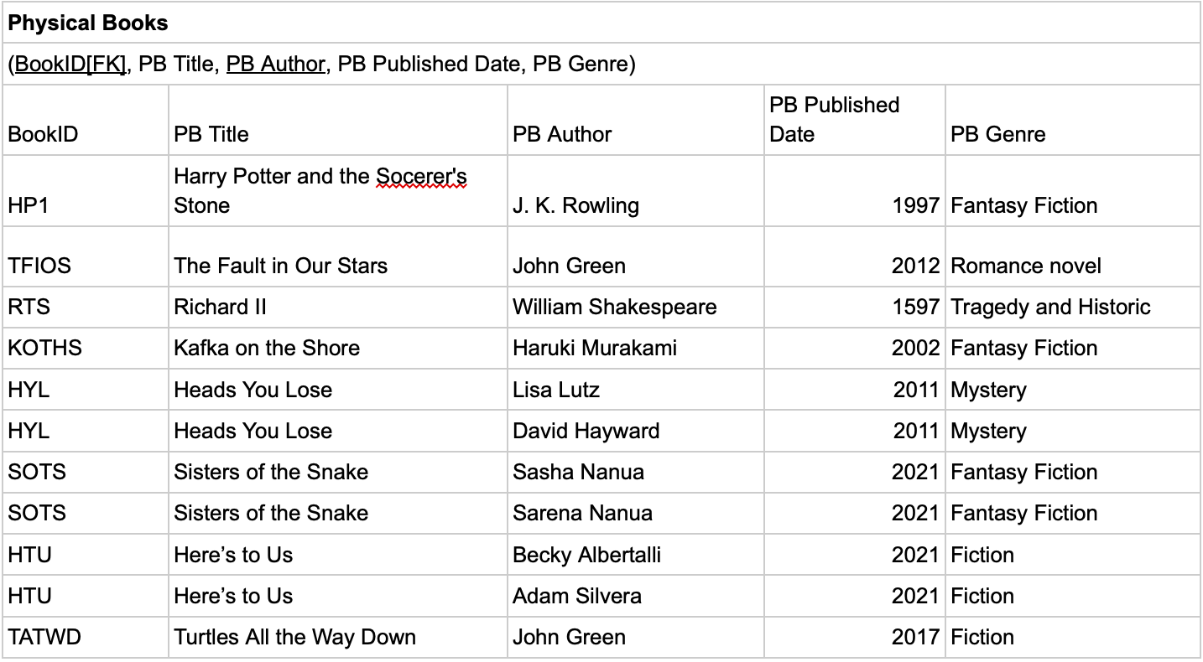
Normalization -Physical Books

Slide 13
Physical Books
Keys: BookID(FK), PBAuthor
FD1: BookID, PBAuthor → PB Title, PB Published Date, PB Genre
FD2: BookID → PB Title, PB Published Date, PB Genre
FD3: PB Title → PB Published Date, PB Genre
1NF: Meets the definition of the relation
2NF: Partial dependencies exist: FD2
3NF: Transitive dependencies exist: FD3
After the normalization, BCNF: All determinants are candidate keys

Slide 14
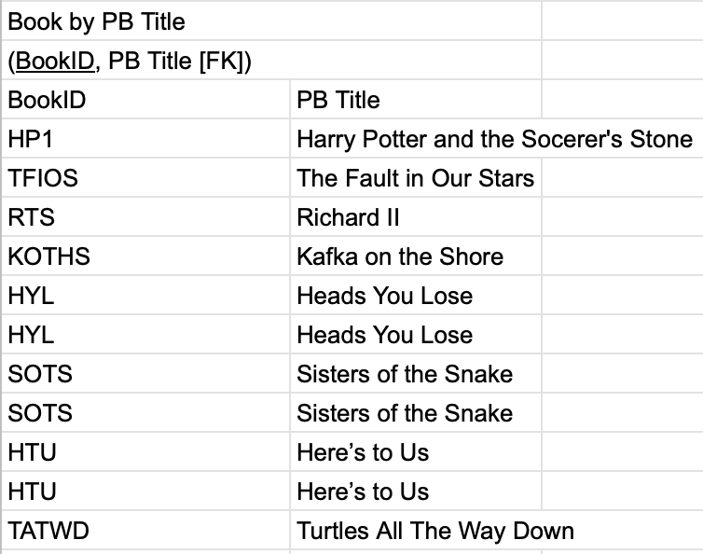
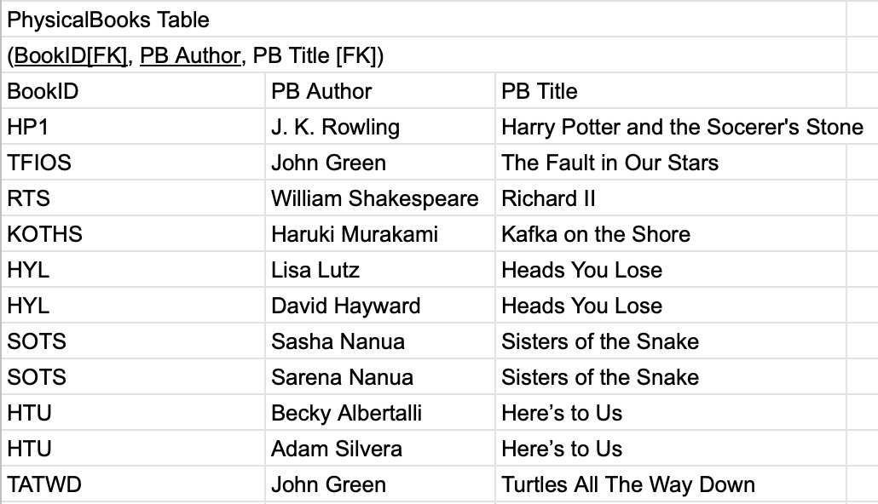
Normalization -Physical Books

Slide 15
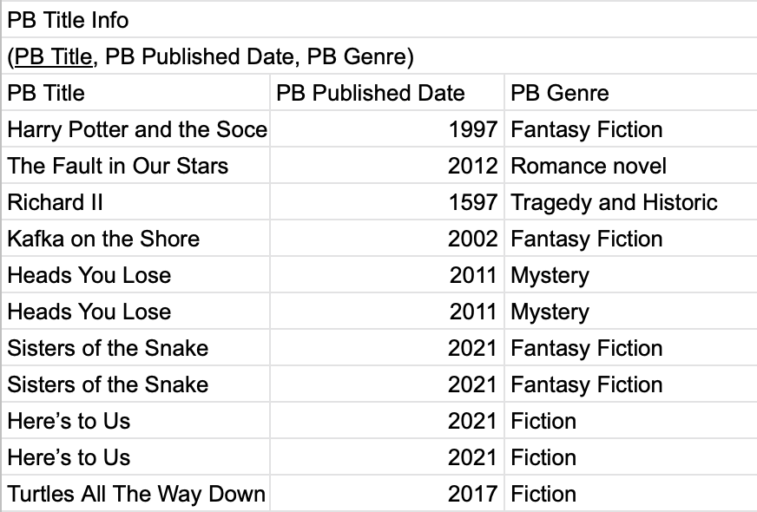
Normalization - Physical Books

Slide 16
Normalization - Audiobooks
Audiobooks
(BookID[FK], AB Title, AB Author, AB Published Date, AB Genre)
BookID | AB Title | AB Author | AB Published Date | AB Genre
HP1 | Harry Potter and the Socerer's Stone | J. K. Rowling | 1997 | Fantasy Fiction
TFIOS | The Fault in Our Stars | John Green | 2012 | Romance novel
RTS | Richard II | William Shakespeare | 1597 | Tragedy and Historic
KOTHS | Kafka on the Shore | Haruki Murakami | 2002 | Fantasy Fiction
HYL | Heads You Lose | Lisa Lutz | 2011 | Mystery
HYL | Heads You Lose | David Hayward | 2011 | Mystery
SOTS | Sisters of the Snake | Sasha Nanua | 2021 | Fantasy Fiction
SOTS | Sisters of the Snake | Sarena Nanua | 2021 | Fantasy Fiction

Slide 17
Audiobooks
Keys: BookID(FK), ABAuthor
FD1: BookID, ABAuthor → AB Title, AB Published Date, AB Genre
FD2: BookID → AB Title, AB Published Date, AB Genre
FD3: AB Title → AB Published Date, AB Genre
1NF: Meets the definition of the relation
2NF: Partial dependencies exist: FD2
3NF: Transitive dependencies exist: FD3
After the normalization, BCNF: All determinants are candidate keys

Slide 18
Normalization - Audiobooks
Audiobooks
AudioBook Table
(BookID[FK], AB Author, AB Title [FK])
BookID | AB Author | AB Title
HP1 | J. K. Rowling | Harry Potter and the Socerer's Stone
TFIOS | John Green | The Fault in Our Stars
RTS | William Shakespeare | Richard II
KOTHS | Haruki Murakami | Kafka on the Shore
HYL | Lisa Lutz | Heads You Lose
HYL | David Hayward | Heads You Lose
SOTS | Sasha Nanua | Sisters of the Snake
SOTS | Sarena Nanua | Sisters of the Snake
Book by AB Title
(BookID, AB Title [FK])
BookID | AB Title
HP1 | Harry Potter and the Socerer's Stone
TFIOS | The Fault in Our Stars
RTS | Richard II
KOTHS | Kafka on the Shore
HYL | Heads You Lose
HYL | Heads You Lose
SOTS | Sisters of the Snake
SOTS | Sisters of the Snake

Slide 19
Normalization - Audiobooks
AB Title Info
(AB Title, AB Published Date, AB Genre)
AB Title | AB Published Date | AB Genre
Harry Potter and the Socerer's Stone | 1997 | Fantasy Fiction
The Fault in Our Stars | 2012 | Romance novel
Richard II | 1597 | Tragedy and Historic
Kafka on the Shore | 2002 | Fantasy Fiction
Heads You Lose | 2011 | Mystery
Heads You Lose | 2011 | Mystery
Sisters of the Snake | 2021 | Fantasy Fiction
Sisters of the Snake | 2021 | Fantasy Fiction

Slide 20
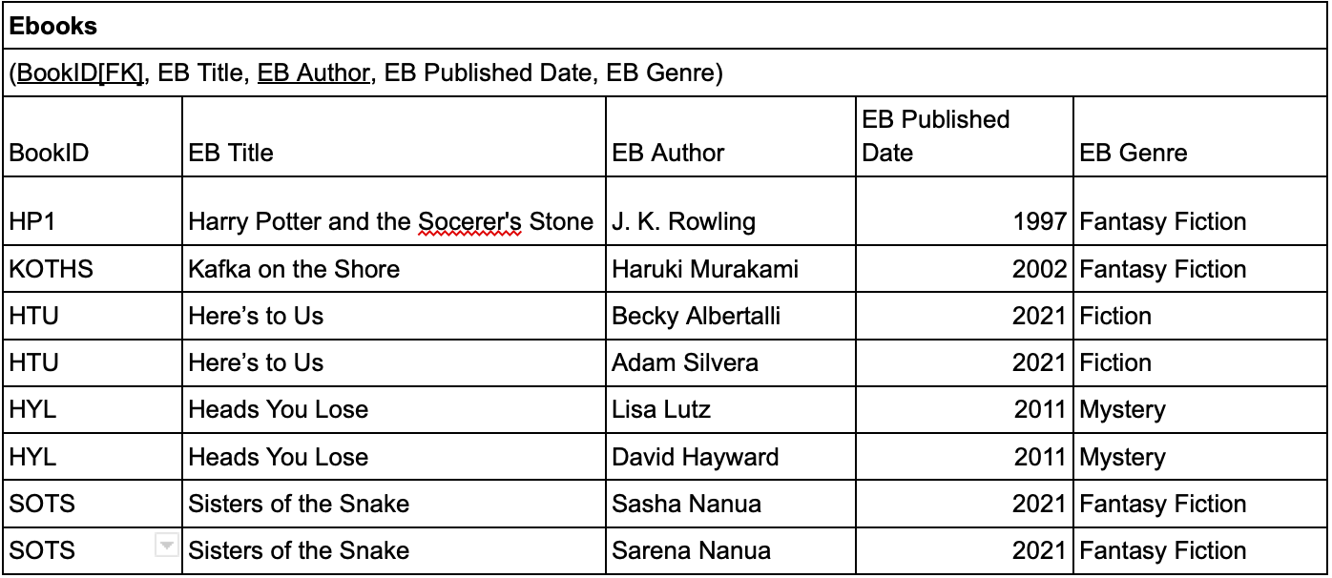
Normalization - Ebooks

Slide 21
Ebooks
Keys: BookID(FK), EBAuthor
FD1: BookID, EBAuthor → EB Title, EB Published Date, EB Genre
FD2: BookID → EB Title, EB Published Date, EB Genre
FD3: EB Title → EB Published Date, EB Genre
1NF: Meets the definition of the relation
2NF: Partial dependencies exist: FD2
3NF: Transitive dependencies exist: FD3
After the normalization, BCNF: All determinants are candidate keys

Slide 22
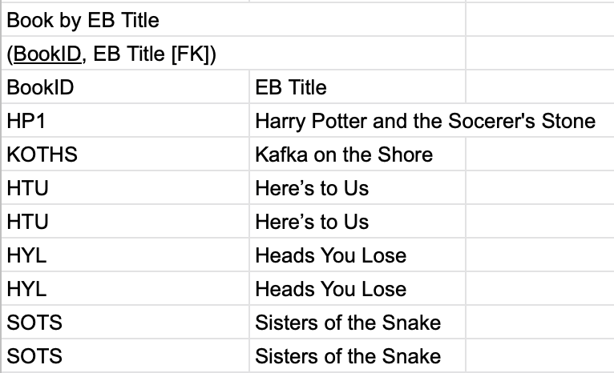
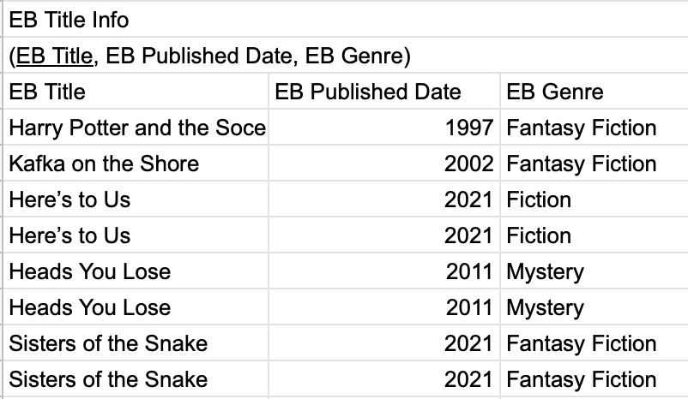
Normalization - Ebooks

Slide 23
Normalization - Checkout Information (Customers/Books)
Checkout Information (Customer/Books)
(CheckoutID, Borrowed Date, Borrowed Time, Due Date, Returned Date, Returned Time, BookID[FK], Category[FK], Customer Card Number[FK])
CheckoutID | Borrowed Date | Borrowed Time | Due Date | Returned Date | Returned Time | Book ID | Category | Customer Card Number
10001 | 03/20/2022 | 12:55 PM | 04/20/2022 | 04/12/2022 | 11:34 AM | TFIOS | Audio Book | 2365
10002 | 02/01/2022 | 10:25 AM | 03/01/2022 | late | late | HP1 | Ebook | 8571
10003 | 11/12/2021 | 2:03 PM | 12/12/2021 | 03/02/2022 | 4:22 PM | RTS | Physical | 9572
10003 | 11/12/2021 | 2:03 PM | 12/12/2021 | 12/10/2021 | 12:25 PM | TATWD | Physical | 9572
10004 | 02/25/2022 | 3:45 PM | 03/25/2022 | n/a | n/a | HP1 | Physical | 8391
10005 | 02/22/2022 | 10:45 AM | 03/22/2022 | N/a | N/a | TFIOS | Physical | 7548
10005 | 02/22/2022 | 10:45 AM | 03/22/2022 | n/a | n/a | HPI | Audio Book | 7548

Slide 24
Checkout Information (Customers/Books)
Keys: CheckoutID, Category(FK), Book ID(FK)
FD1: CheckoutID, Category, BookID → Borrowed Date, Borrowed Time, Due Date, Customer Card Number(FK), Returned Date, Returned Time
FD2: CheckoutID, Category → Borrowed Date, Borrowed Time, Due Date, Customer Card Number(FK)
FD3: CheckoutID → Borrowed Date, Borrowed Time, Due Date, Customer Card Number(FK)
FD4: Borrowed Date → Due Date
1NF: Meets the definition of the relation
2NF: Partial dependencies exist: FD2, FD3
3NF: Transitive dependencies exist: FD4
After the normalization, BCNF: All determinants are candidate keys

Slide 25
Normalization - Checkout Information (Customers/Books)
Checkout Information (Customers/Books)
CheckOut Table
(CheckoutID, , BookID[FK], Category[FK], Borrowed Date [FK], Returned Date, Returned Time)
CheckoutID | Book ID | Category | Borrowed Date | Returned Date | Returned Time
10001 | TFIOS | Audio Book | 03/20/2022 | 04/12/2022 | 11:34 AM
10002 | HP1 | Ebook | 02/01/2022 | late | late
10003 | RTS | Physical | 11/12/2021 | 03/02/2022 | 4:22 PM
10003 | TATWD | Physical | 11/12/2021 | 12/10/2021 | 12:25 PM
10004 | HP1 | Physical | 02/25/2022 | n/a | n/a
10005 | TFIOS | Physical | 02/22/2022 | N/a | N/a
10005 | HP1 | Audio Book | 02/22/2022 | n/a | n/a

Slide 26
Normalization - Checkout Information (Customers/Books)
CheckOut by Category
(CheckoutID, Category, Borrowed Date [FK])
CheckoutID | Category | Borrowed Date
10001 | Audio Book | 03/20/2022
10002 | Ebook | 02/01/2022
10003 | Physical | 11/12/2021
10003 | Physical | 11/12/2021
10004 | Physical | 02/25/2022
10005 | Physical | 02/22/2022
10005 | Audio Book | 02/22/2022

Slide 27
Normalization - Checkout Information (Customers/Books)
Checkout Customer Card Number
(Checkout ID, Customer Card Number, Borrowed Date [FK], Borrowed Time)
CheckoutID | Customer Card Number (FK) | Borrowed Date | Borrowed Time
10001 | 2365 | 03/20/2022 | 12:55 PM
10002 | 8571 | 02/01/2022 | 10:25 AM
10003 | 9572 | 11/12/2021 | 2:03 PM
10003 | 9572 | 11/12/2021 | 2:03 PM
10004 | 8391 | 02/25/2022 | 3:45 PM
10005 | 7548 | 02/22/2022 | 10:45 AM
10005 | 7548 | 02/22/2022 | 10:45 AM
Borrowed Date
(Borrowed Date, Due Date)
Borrowed Date | Due Date
03/20/2022 | 04/20/2022
02/01/2022 | 03/01/2022
11/12/2021 | 12/12/2021
11/12/2021 | 12/12/2021
02/25/2022 | 03/25/2022
02/22/2022 | 03/22/2022
02/22/2022 | 03/22/2022

Slide 28
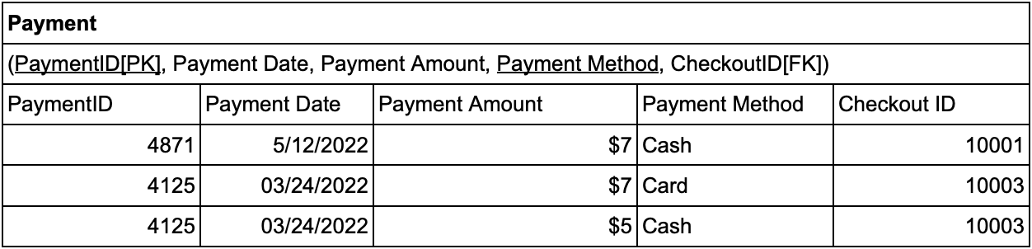
Normalization - Payment
Key: PaymentID(PK), Payment Method(PK)
FD1: PaymentID(PK), Payment Method(PK) → Payment Date, Payment Amount, Checkout ID(FK)
FD2: PaymentID → CheckoutID
1NF: Meets the definition of the relation
2NF: Partial dependencies exist: FD2
3NF: No transitive dependencies
After the normalization, BCNF: All determinants are candidate keys

Slide 29
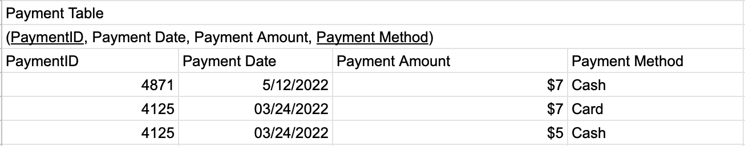
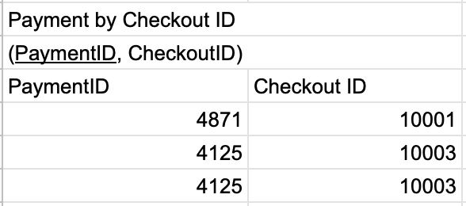
Normalization - Payment

Slide 30
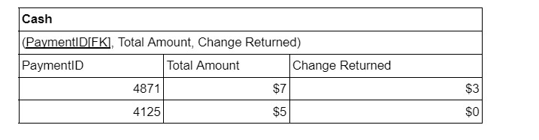
Normalization - Cash
Key: PaymentID
FD1: PaymentID → Total Amount, Change Returned
1NF: Meets the definition of the relation
2NF: No partial dependencies
3NF: No transitive dependencies
After the normalization, BCNF: All determinants are candidate keys

Slide 31
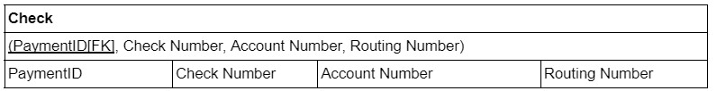
Normalization- Check
Key: PaymentID
FD1: PaymentID → Check Number, Account Number, Routing Number
1NF: Meets the definition of the relation
2NF: No partial dependencies
3NF: No transitive dependencies
After the normalization, BCNF: All determinants are candidate keys

Slide 32
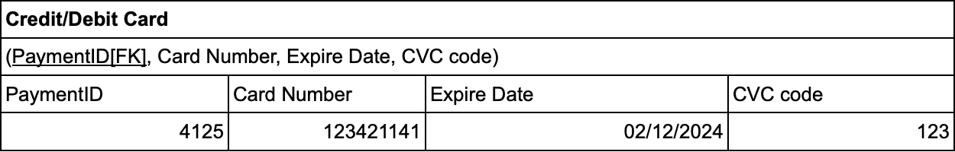
Normalization - Credit/Debit Card
Key: PaymentID
FD1: PaymentID → Card Number, Expiry Date, CVC Code
FD2: Card Number → Expiry Date, CVC
1NF: Meets the definition of the relation
2NF: No partial dependencies
3NF: Transitive dependencies exist: FD2
BCNF: All determinants are candidate keys

Slide 33
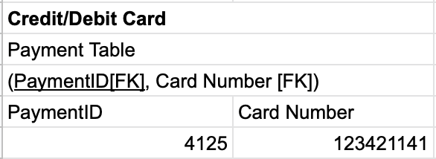
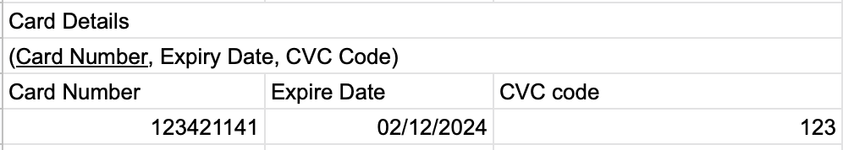
Normalization - Credit/Debit Card

